Slide 1
Find the Best City and Neighborhood to set a Bakery Shop business in the U.S.
Applied Data Science Capstone Project IBM/Coursera¶
by
Federico Sarrailh

Slide 2
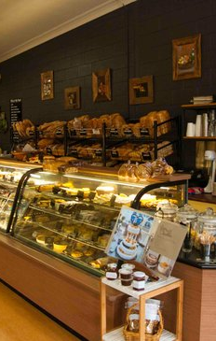
Find the Best City and Neighborhood to set a Bakery Shop business in the U.S.
An investor is trying to find out where to open a Bakery Shop in the United States
Find the best city in terms of population and income per capita
Must compare neighborhoods and their venues to decide
Possible locations should have the less possible of:
Bakeries
Coffee Shops
Preference for locations as close to city center as possible

Slide 3
2. Data description and SOURCES
2.1 - description
More populated and better income per capita cities in the US
Potential competing food venues in each neighborhood
Must compare neighborhoods and their venues to decide
Any Bakery or Cofee shop in the neighborhoods?
Distance of neighborhoods from city center
FACTORS OF INFLUENCE:
2.2- sources
top populated US cities with better per capita income, will be obtained by web scrapping
data link: https://www.statista.com/statistics/205618/per-capita-income-in-the-top-20-most-populated-cities-in-the-us/
neighborhoods in the chosen cities, will be obtained by Wikipedia web scrapping
data link: https://www.statista.com/statistics/205618/per-capita-income-in-the-top-20-most-populated-cities-in-the-us/
data link: https://en.wikipedia.org/wiki/List_of_neighborhoods_in_Seattle
cities and neighborhoods location data using Nominatim geocoding
venues and their type and location in every neighborhood using Foursquare API
Representation maps using Folium
Representation graphs using Plotly and Matplotlib
Needed to extract / generate:

Slide 4
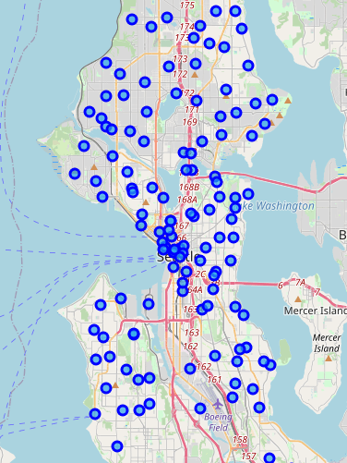
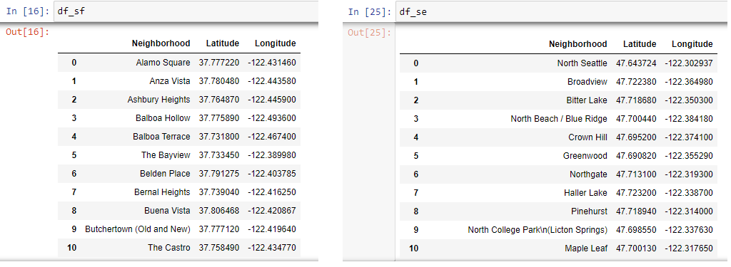
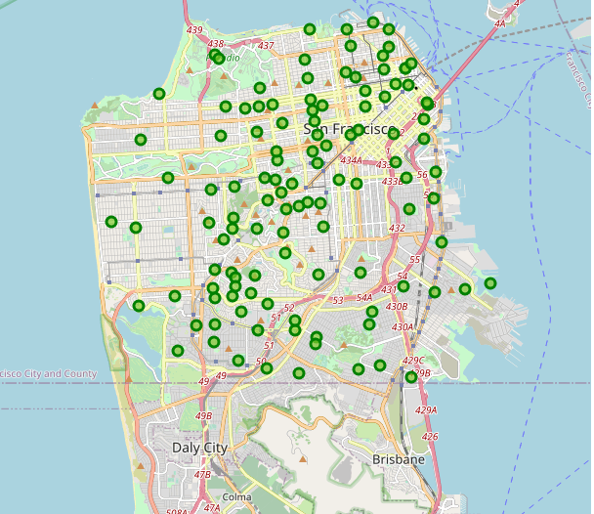
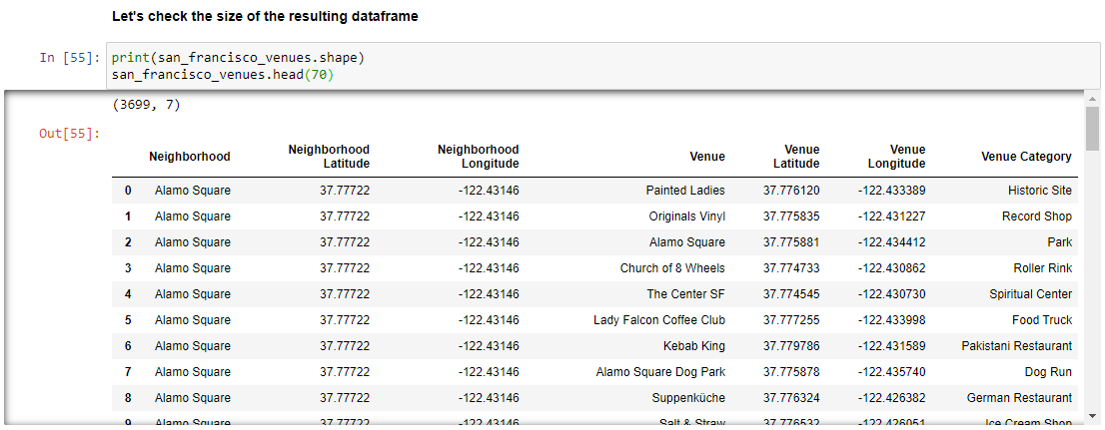
3. METHODOLOGY
3.1.X – PROCEDURE STEPS
Scrapping info about more populated and better income per capita cities
We choose the top 2 for simplification
Individualize each neighborhood
Map representation
Exploring neighborhoods in terms of venues
Seattle
San Francisco

Slide 5
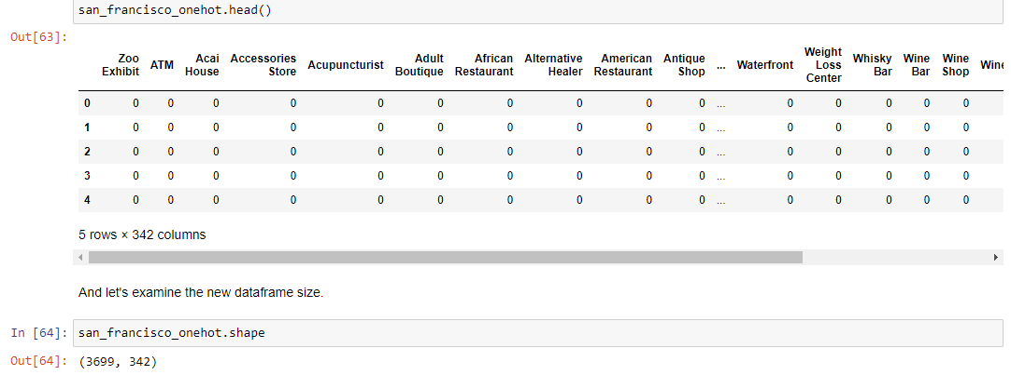
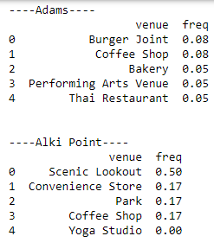
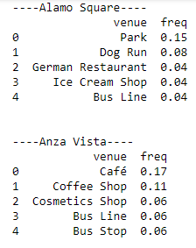
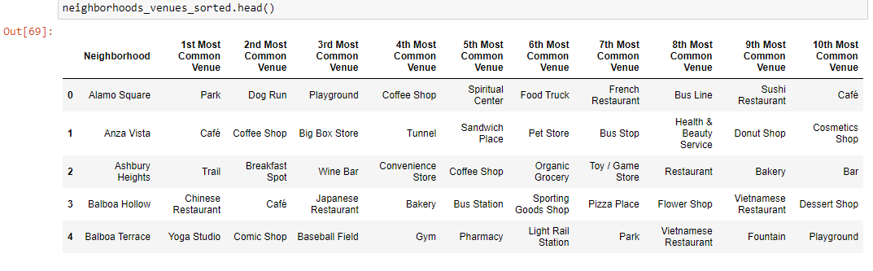
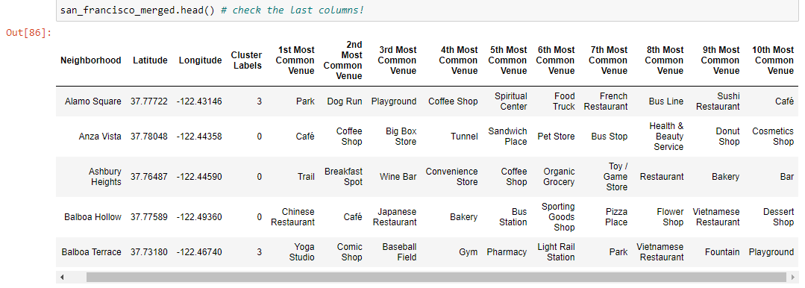
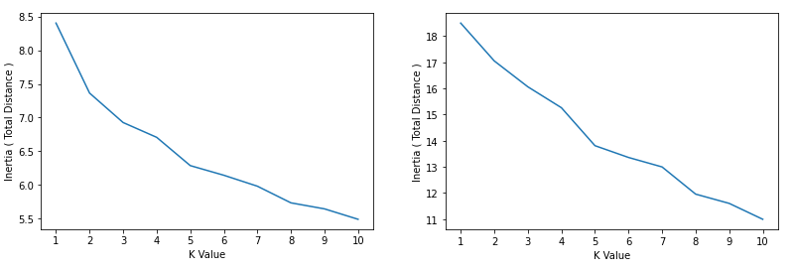
3. METHODOLOGY
3.1.x – PROCEDURE STEPS
Normalization and grouping by venues data
Clustering the neighborhoods through a ML model
One-hot encoding
Dataframe with Cluster Labels and Top 10 venue categories for each neighborhood
k- means algorithm

Slide 6
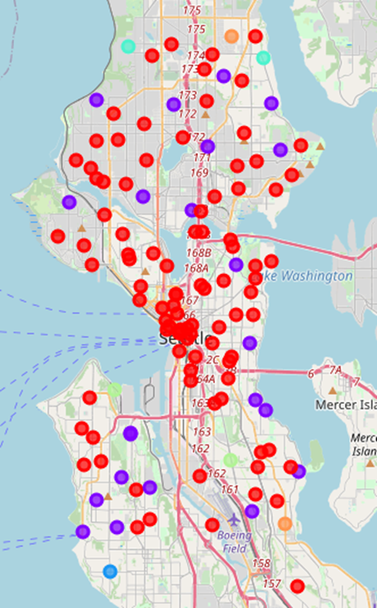
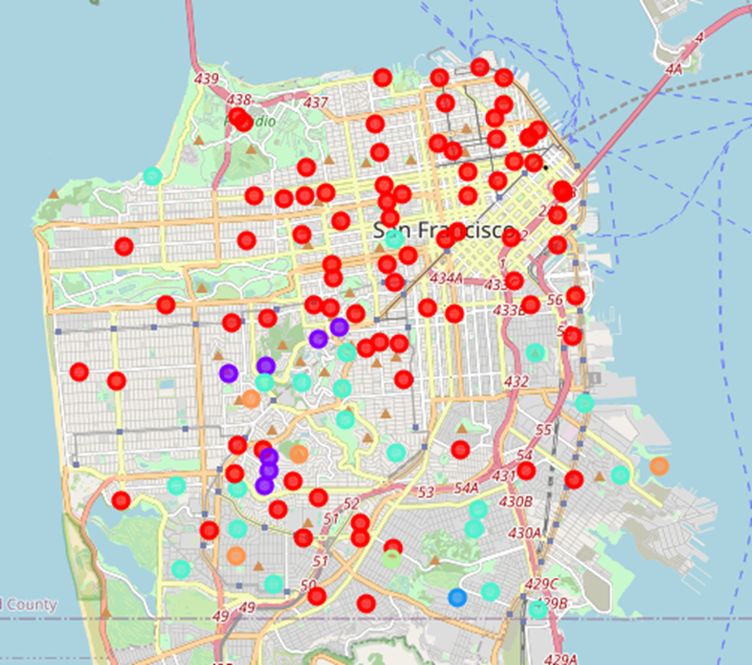
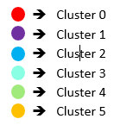
3. METHODOLOGY
3.1.x – PROCEDURE STEPS
Numerical & Examination for each group -> determine the discriminating venue categories
San Francisco
Seattle

Slide 7
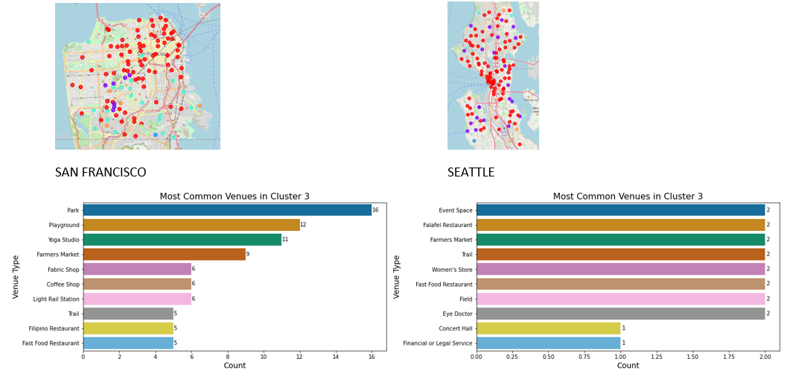
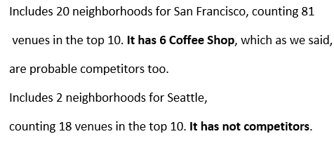
3. METHODOLOGY
3.1.x – PROCEDURE STEPS
Numerical & Examination for each group -> determine the discriminating venue categories
FOR EXAMPLE FOR CLUSTER 3 THE VENUES DISTRIBUTION:

Slide 8
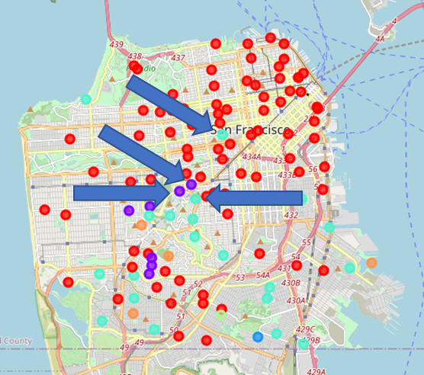

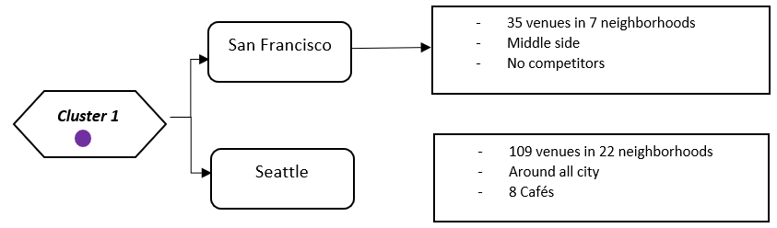
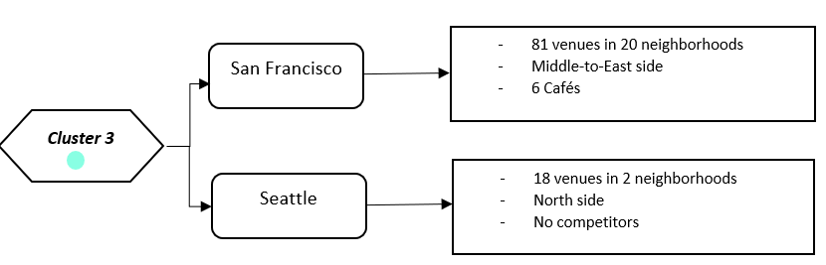
4. RESULTS
SAN FRANCISCO AND POTENTIAL NEIGHBORHOODS
Decided to stay with SAN FRANCISCO city since it has $10 K dollars more in per capita income compared to SEATTLE.
POINTED NEIGHBORHOODS ARE FROM CLUSTER 1 AND CLUSTER 3

Slide 9

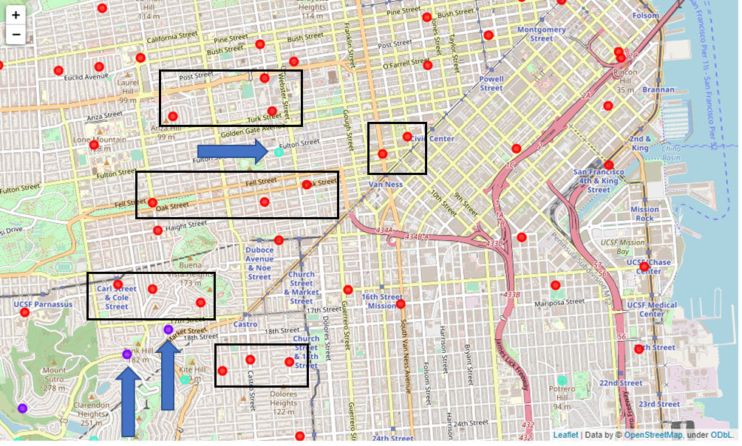

4. RESULTS
SAN FRANCISCO AND POTENTIAL NEIGHBORHOODS
ZOOM IN
A
Alamo Square
2. Upper Market
3. Clarendon Heights
4. Twin Peaks.
B
1
C
D
2
3
E
4

Slide 10
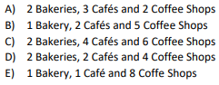
5. Discussion and conclusion
SAN FRANCISCO AND POTENTIAL NEIGHBORHOODS
CLOSER
LOOK
A
B
1
check if any bakeries or coffee shops in the neighborhoods within the rectangles?
C
D
2
recommendation to the investor
Neighborhood 4 : Twin Peaks
3
E
4

